Slide 1


Website
CS 401: Software Engineering and Design
Chaminade University of Honolulu
Quinn, Logan, Ashley

Slide 2
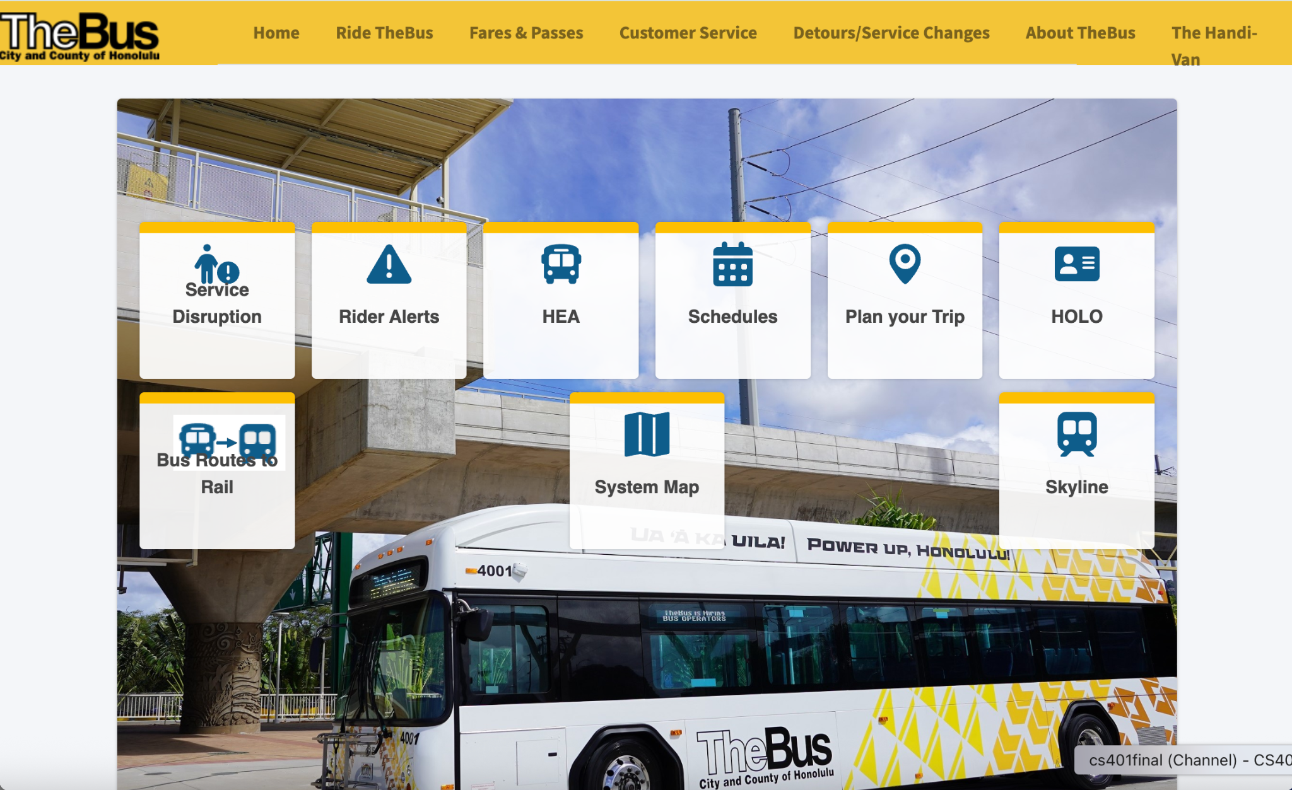
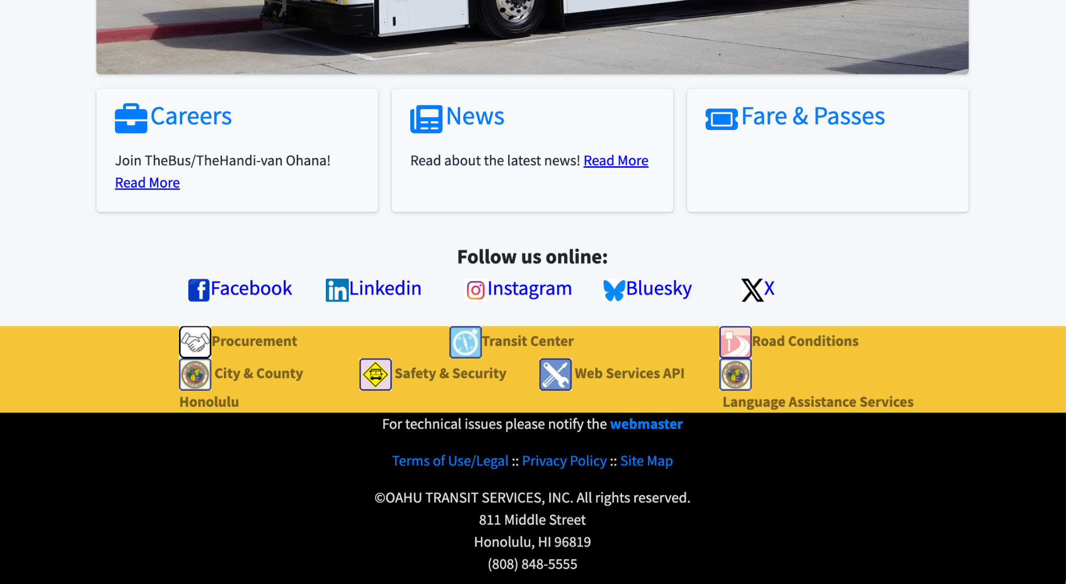
The Problem
TheBus is the only public bus transportation service on the island of Oʻahu, Hawai'i. Although this service has been around since 1971 and serves a large population, finding a bus can be a difficult task. Additionally, the current official website for company is very outdated and not user friendly. Thus, we wanted to create a solution. Our group decided to create a web based software application which assists the general public in navigating public transportation systems, specifically TheBus.
https://www.thebus.org/

Slide 3
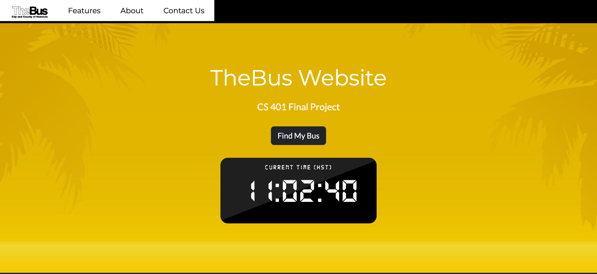
The Solution

Slide 4
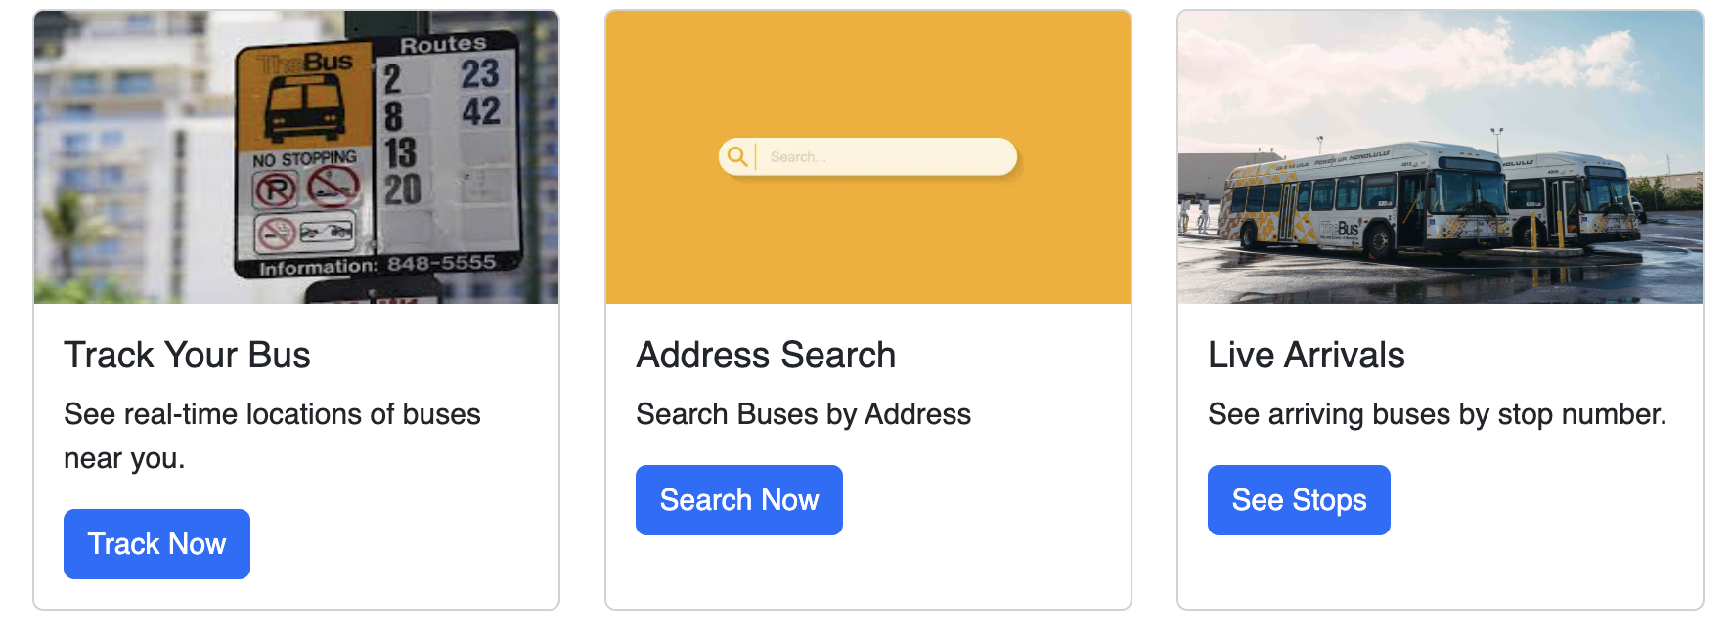
Our Models

Slide 5
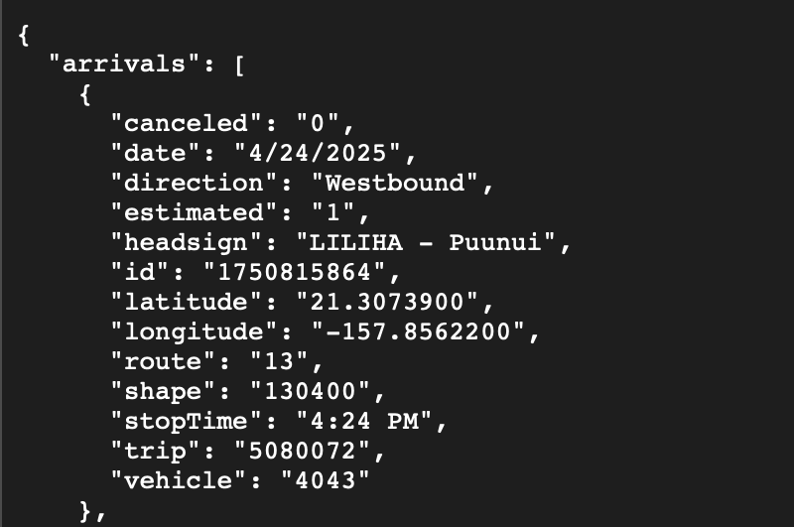
API
Oahu Transit Services API
JSON or XML
Updates every ~1.5 seconds
Publicly accessible with a key
Needs a bus stop ID as a parameter - this was one of our challenges

Slide 6


Front End
W3Schools CSS template
Bootstrap
Look and feel of TheBus branding

Slide 7
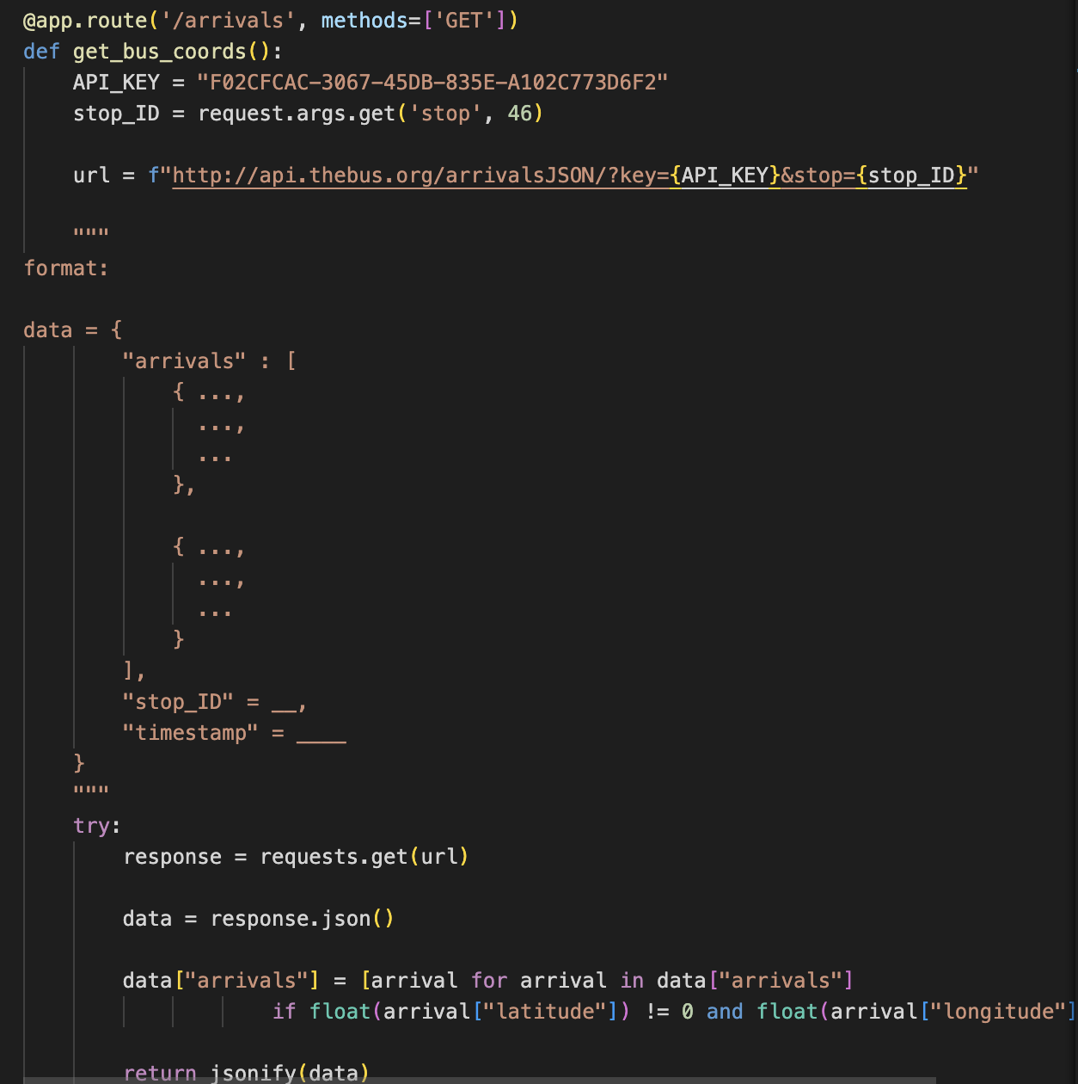
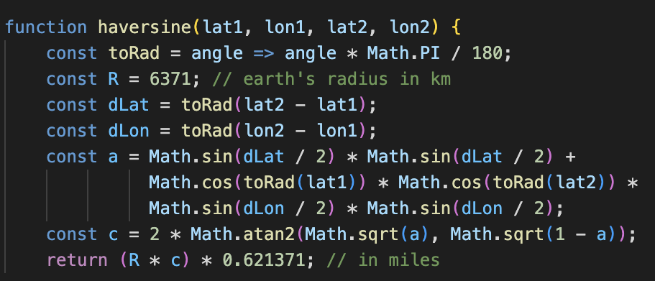
Back End
Javascript for all mapping (map textures, markers, updating marker positions) and for calculating distance for closest stops
Flask app for routes and API

Slide 8
Live Demo
http://127.0.0.1:5000/

Slide 9
Challenges and Future Improvements
Challenges
API parameters
Data formatting through TheBus API
Future Improvements
Interactive design of website, response time for the map, visualize the routes on the map, user customization, alerts for when a bus is delayed

Slide 10
Thank you!

